Slide 1
Molecular Biology Biol 480
Lecture 30 April 12th , 2019

Slide 2
Announcements/Assignments
Now to end of semester schedule—Let’s go over
Have not had requests for papers for your presentation—Please don’t hesitate to ask. I can get papers pretty quickly. Most same day.

Slide 3
Where were we?...Gene expression regulation in Eukaryotes
Lac operon
Trp operon
How is the Trp operon repressed when Trp is really abundant?
What happens when Trp is really low?
How does attenuation work? Why is it linked to transcription and translation occurring simultaneously?
AraBAD operon
How is it similar and different from the LAC operon?
How was it used to develop pGLO/pBAD plasmid

Slide 4
Test your understanding
As it turns out, other amino acids are synthesized using enzymes encoded in operons. Several of them show attenuation mechanisms. The His (Histidine) operon is an example.
What do you think the leader sequence of the His operon might look like?
How might you identify to which operon a leader sequence belongs?

Slide 5
Where were we?...
Eukaryotic gene expression regulation---chapter 17.
Basal level transcription factors
Proximal promoter elements and transcription factors
Gene specific cis and trans elements

Slide 6
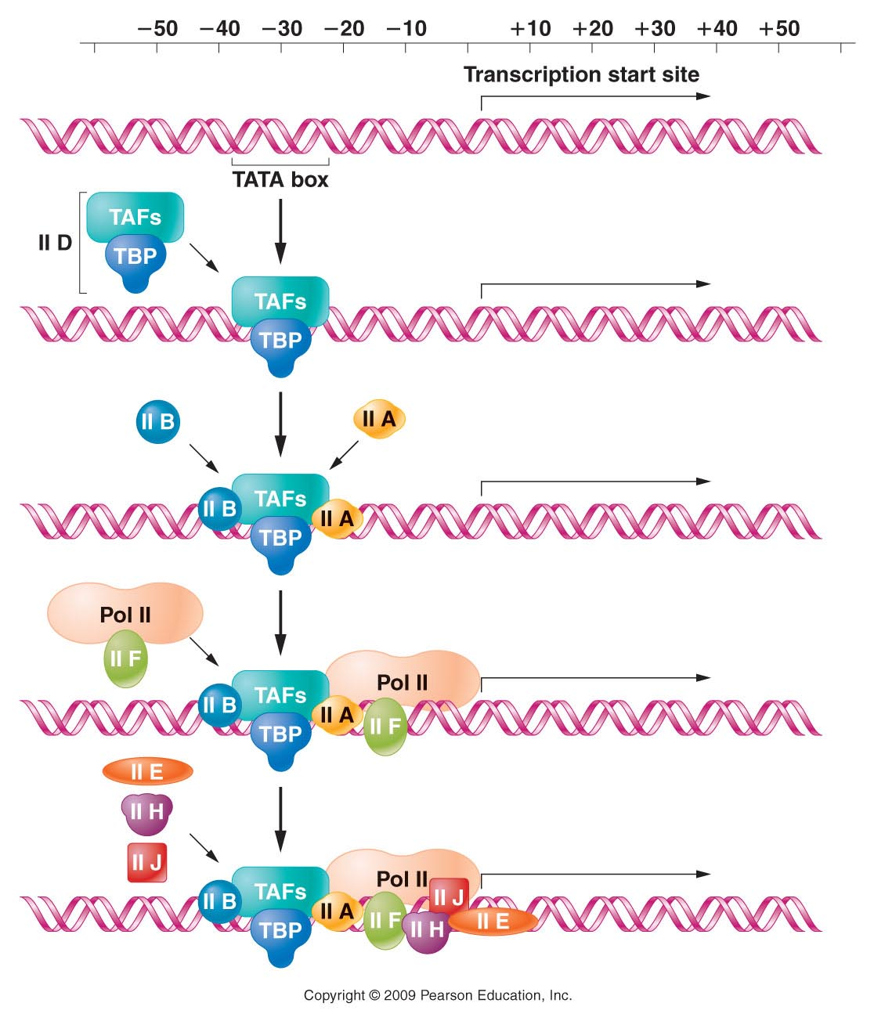
Basal level regulation
Figure 18.14
Notes:
Figure 18-14 The assembly of transcription factors required for the initiation of transcription by RNA polymerase II.

Slide 7
A specific, complex regulation system! Metallothionein gene expression.
Figure 18.10
Notes:
Figure 18-10 The human metallothionein IIA gene promoter and enhancer regions, containing multiple cis-acting regulatory sites. The transcription factors controlling both basal and induced levels of MTIIA transcription are indicated below the gene, with arrows showing their binding sites.

Slide 8
Model organisms for eukaryotes?
Yeast are single celled, reproduce asexually, are easy to maintain on media plates, and can be manipulated by mutation or other directed genetic alteration.
However, they are Eukaryotic cells!

Slide 9
Gal gene regulation in yeast
Yeast are like prokaryotes in many ways. They are single celled organisms that are greatly affected by their immediate environment.
They must be able to alter gene expression quickly and efficiently to accommodate changing conditions and to use carbons sources efficiently

Slide 10
They are set up to use glucose most of the time.
But they can utilize other sugars (such as galactose) when they are available and glucose is not.
Sounds familiar?...

Slide 11
The GAL locus/complex consists of several genes encoding enzymes for galactose metabolism. (catabolism, right?)
This is not considered an operon, since each gene encodes its own, monocistronic mRNA, but the genes do share cis elements that allow coordinated control of several genes.

Slide 12
Regulatory region for both GAL10 and GAL1
Figure 18.16a
Notes:
Figure 18-16a Model of GAL1 and GAL10 UAS structures showing the binding sites for the Gal4p positive regulator and their interaction with the Gal80p negative regulator. Induction is shown as the structure of the Gal80p becomes altered, exposing the activation domain of Gal4p.

Slide 13
The GAL10 and GAL1 genes share a regulatory sequence call an Upstream Activating Sequence(UAS_{G})
UAS sequences are functionally the same as enhancers.
This cis element is constitutively “open chromatin” as shown by its DNase hypersensitivity.
The ability for a DNA region to be cut with Dnase indicates it is not buried in higher order chromatin structure.

Slide 16
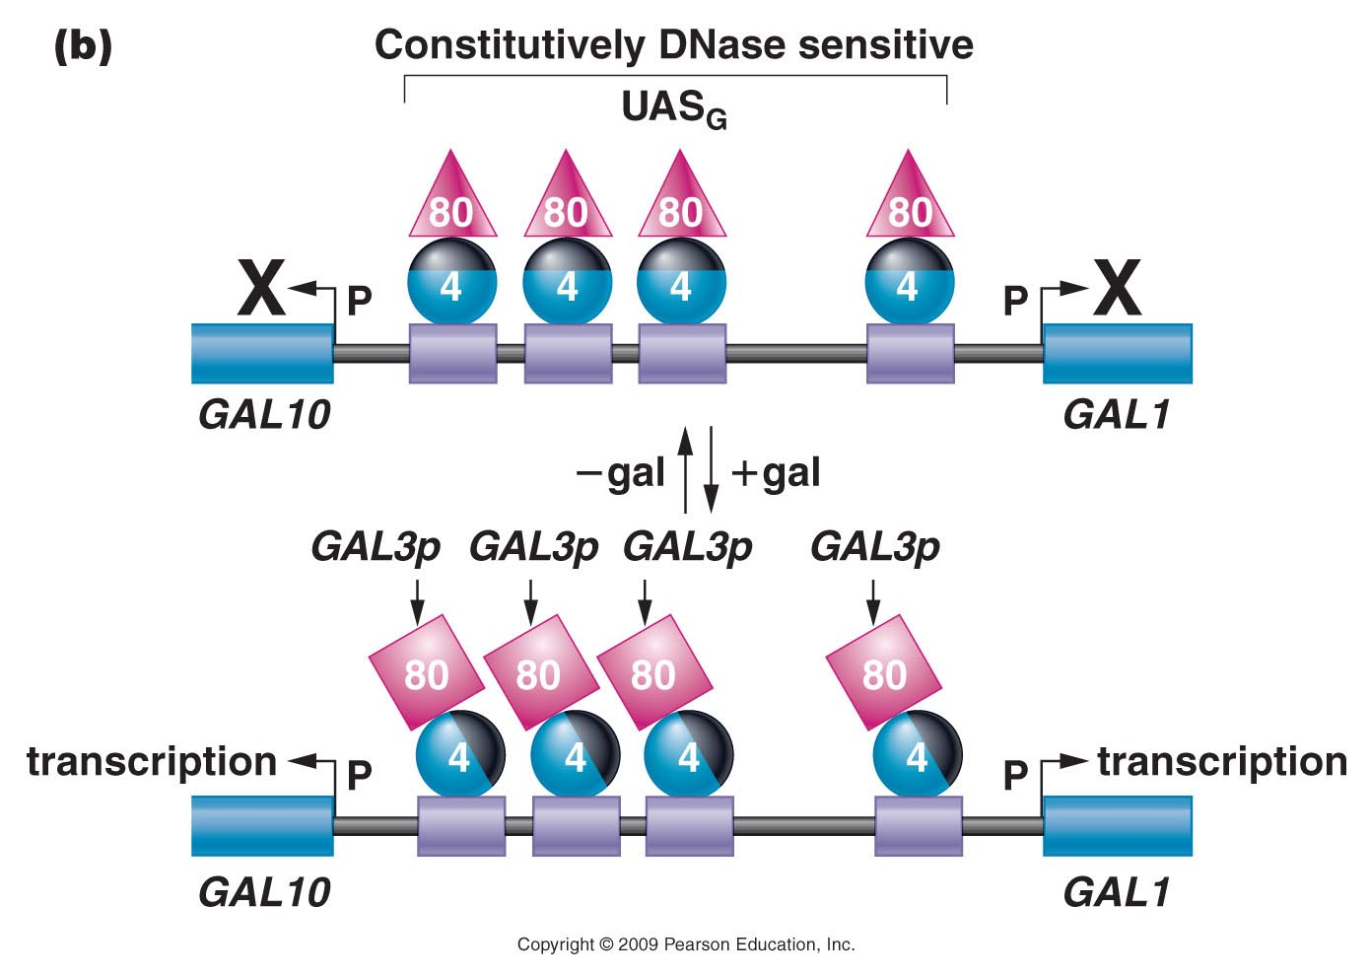
Figure 18.16b
Notes:
Figure 18-16b Model of GAL1 and GAL10 UAS structures showing the binding sites for the Gal4p positive regulator and their interaction with the Gal80p negative regulator. Induction is shown as the structure of the Gal80p becomes altered, exposing the activation domain of Gal4p.

Slide 17
The UAS_{G} is permanently occupied by several molecules of a protein known as Gal4p
A second protein, Gal80p, binds to Gal4p and covers an important activation domain of Gal4p.

Slide 18
Figure 18.16b
Notes:
Figure 18-16b Model of GAL1 and GAL10 UAS structures showing the binding sites for the Gal4p positive regulator and their interaction with the Gal80p negative regulator. Induction is shown as the structure of the Gal80p becomes altered, exposing the activation domain of Gal4p.

Slide 19
When galactose (sugar) is available and glucose is not, galactose binds to Gal80p and alters its conformation.
Gal80p no longer covers Gal4p’s transcription activation domain and Gal4p helps RNApol (via the usual TFs) bind the promoter of both GAL1 and GAL10 genes.

Slide 20
Figure 18.16b
Notes:
Figure 18-16b Model of GAL1 and GAL10 UAS structures showing the binding sites for the Gal4p positive regulator and their interaction with the Gal80p negative regulator. Induction is shown as the structure of the Gal80p becomes altered, exposing the activation domain of Gal4p.

Slide 21
GAL1 and GAL10 mRNA is produced allowing GAL1 and GAL10 proteins to be translated.
GAL 1/10 proteins break down available galactose and allow the yeast cell to gain energy.
Familiar system! Galactose is the inducer of the galactose catabolizing proteins.

Slide 22
Connecting concepts…
Say you come across a yeast strain that seems to NOT be inducible by galactose…what could be wrong? How could you test your hypothesis?
Say you come across a yeast strain that seems to be constitutively expressing GAL1 and GAL10…What could be wrong? How could you test your hypothesis?

Slide 23
Read more in your text!
Study figure 17-12

Slide 24
What about multicellular organisms…How do they make so many different cell types from “one recipe” (the exact same genome)?
In a sense cell differentiation depends on the cells ability to read certain parts of the recipe book, and completely ignore others.

Slide 25
Let’s step back a little…
You’ve probably heard lots of stories in the news about stem cells.
Before a zygote undergoes a certain number of cell divisions, the every part of the recipe has the potential to be read. Each cell is completely undifferentiated, unspecialized.
These are embryonic stem cells. These cells are described as totipotent.

Slide 26
But after an embryo is about 50 cells in size, the cells start to look and act differently from each other.
Most of this differentiation involves transcriptional regulation. Embryonic development involves some general differentiation into 3 tissue types: ectoderm, endoderm, and mesoderm. Cells in these tissues can still become lots of different types of cells…they are said to be pluripotent.

Slide 27
Read independently---about these 3 types of germ tissue.
http://en.wikipedia.org/wiki/Germ_layer#Germ_layers

Slide 28
Adult stem cells also exist. A good example is the hematopoietic stem cell that hangs out in your bone marrow. These cells can divide and stay undifferentiated or differentiate into any of the blood cells you need.
They are called multi-potent. They can become blood cells…but not muscle or lungs... or liver….etc.

Slide 30
By the way…the program that drives the hematopoietic cell along any differentiation path is…you guessed it…due to specific genetic regulation!

Slide 31
Back to ES cells…
The take home message is that each type of tissue becomes more and more specialized because of the different subset of proteins made by the cell contained in it.
Most of the cell-specific proteins are due to strict transcriptional regulation.

Slide 32
For example…
Muscle cells transcribe a set of genes that encode proteins that allow… elongation and strength and flexibility. Muscle cells ignore many other genes!
Bone cells transcribe a set of genes that encode proteins that make rigid, strong, inflexible tissue. Bone cells ignore other genes (including those expressed in muscle cells)!

Slide 33
Lets focus briefly on muscle…
How does a totipotent embryonic stem cell become a muscle cell?
ES cells begin to make some different proteins that control expression of certain genes. Some of the ES cells transform into mesoderm…some of which goes on to differentiate into muscle cells.

Slide 34
MyoD
MyoD is one of the important proteins that pushes a cell to differentiate into a muscle cell.
MyoD gene encodes a protein that IS a transcription factor. It belongs to a family of proteins called myogenic regulators.

Slide 35
The myoD protein has a DNA binding motif called a basic helix-loop-helix motif. Myo D binds to regulatory regions of other genes---genes that encode proteins the contribute to the function of muscle cells.
http://en.wikipedia.org/wiki/MyoD

Slide 36
Myo D
Regulatory sequence of a gene needed for muscle function

Slide 37
The presence of MyoD in a cell pushes it to express genes with MyoD binding sites in their promoters.
Even though all your genes are present in muscle cells …only proteins needed in muscle are encoded by genes with MyoD-binding promoters.

Slide 38
A general look at a MyoD binding promoter
Tell me what you recognize in this figure!

Slide 39
Much work on Myo D has been done in an attempt to understand and find treatment for Muscular Dystrophy.
Why? Understanding muscle cell differentiation is essential in understanding muscle-related diseases…MD represents a “mutant” form of muscle cell function.

Slide 40
How could your understanding of MyoD and its role in muscle-specific gene expression help in designing a treatment?
Use examples from recent lectures to help you think this over….

Slide 41
Look into at least one other system for cell-type specific gene expression.
For example…how do specific blood cells become those blood cells (starting with a hematopoietic stem cell? Recall Oct-1 and Oct-2 proteins?

